Slide 1
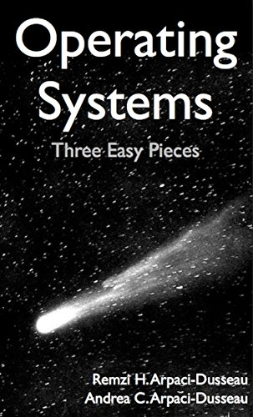
Computer Operating Systems BLG 312E Week -3
Prof. Dr. Kemal Bıçakcı

Slide 2
Review of Last Week

Slide 3
Review Question
Which of these process state transitions is not possible?
Ready → Running
Blocked → Running
Running → Ready
Running → Blocked

Slide 4
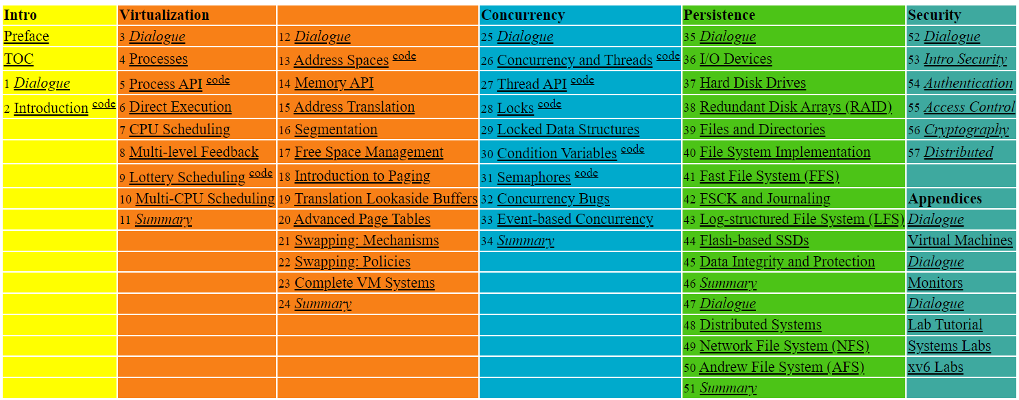

Slide 5
7. Scheduling: Introduction
Operating System: Three Easy Pieces

Slide 6
Scheduling: Introduction
(Initial) Workload assumptions:
Each job runs for the same amount of time.
All jobs arrive at the same time.
All jobs only use the CPU (i.e., they perform no I/O).
The run-time of each job is known.

Slide 7

Scheduling Metrics
Performance metric: Turnaround time
The time at which the job completes minus the time at which the job arrived in the system.
Another metric is fairness.
Performance and fairness are often at odds in scheduling.
$$T_{turnaround}=T_{completion}−T_{arrival}$$

Slide 8

First In, First Out (FIFO)
First Come, First Served (FCFS)
Very simple and easy to implement
Example:
A arrived just before B which arrived just before C.
Each job runs for 10 seconds.
A
B
C
0
20
40
60
80
100
120
Time (Second)
$$Average turnaround time=\frac{10+20+30}{3}=20 sec$$

Slide 9
Why FIFO is not that great? – Convoy effect
Let’s relax assumption 1: Each job no longer runs for the same amount of time.
Example:
A arrived just before B which arrived just before C.
A runs for 100 seconds, B and C run for 10 each.
A
B
C
0
20
40
60
80
100
120
Time (Second)
$$Average turnaround time=\frac{100+110+120}{3}=110 sec$$

Slide 10

Shortest Job First (SJF)
Run the shortest job first, then the next shortest, and so on
Non-preemptive scheduler
Example:
A arrived just before B which arrived just before C.
A runs for 100 seconds, B and C run for 10 each.
B
C
A
0
20
40
60
80
100
120
Time (Second)
$$Average turnaround time=\frac{10+20+120}{3}=50 sec$$

Slide 11
SJF with Late Arrivals from B and C
Let’s relax assumption 2: Jobs can arrive at any time.
Example:
A arrives at t=0 and needs to run for 100 seconds.
B and C arrive at t=10 and each need to run for 10 seconds
[B,C arrive]
A
B
C
0
20
40
60
80
100
120
Time (Second)
$$Average turnaround time=\frac{100+\left(110−10\right)+(120−10)}{3}=103.33 sec$$

Slide 12
Shortest Time-to-Completion First (STCF)
Add preemption to SJF
Also knows as Preemptive Shortest Job First (PSJF)
A new job enters the system:
Determine time-to-completion of the remaining jobs and new job
Schedule the job which has the least time left

Slide 13
Shortest Time-to-Completion First (STCF)
Example:
A arrives at t=0 and needs to run for 100 seconds.
B and C arrive at t=10 and each need to run for 10 seconds
[B,C arrive]
A
B
C
A
0
20
40
60
80
100
120
Time (Second)
$$Average turnaround time=\frac{(120−0)+\left(20−10\right)+(30−10)}{3}=50 sec$$

Slide 14

New scheduling metric: Response time
The time from when the job arrives to the first time it is scheduled.
STCF and related disciplines are not particularly good for response time.
$$T_{response}=T_{firstrun}−T_{arrival}$$
How can we build a scheduler that is
sensitive to response time?

Slide 15
Round Robin (RR) Scheduling
Time slicing Scheduling
Run a job for a time slice and then switch to the next job in the run queue until the jobs are finished.
Time slice is sometimes called a scheduling quantum.
It repeatedly does so until the jobs are finished.
The length of a time slice must be a multiple of the timer-interrupt period.
RR is fair, but performs poorly on metrics
such as turnaround time

Slide 16


RR Scheduling Example
A, B and C arrive at the same time.
They each wish to run for 5 seconds.
A
B
C
$$T_{average response}=\frac{0+5+10}{3}=5sec$$
0
5
10
15
20
25
30
Time (Second)
SJF (Bad for Response Time)
A
B
A
B
A
B
A
B
A
C
C
C
C
B
C
$$T_{average response}=\frac{0+1+2}{3}=1sec$$
0
5
10
15
20
25
30
Time (Second)
RR with a time-slice of 1sec (Good for Response Time)

Slide 17
The length of the time slice is critical
The shorter time slice
Better response time
The cost of context switching will dominate overall performance.
The longer time slice
Amortize the cost of switching
Worse response time
Deciding on the length of the time slice presents
a trade-off to a system designer

Slide 18
Incorporating I/O
Let’s relax assumption-3: All programs perform I/O
Example:
A and B need 50ms of CPU time each.
A runs for 10ms and then issues an I/O request
I/Os each take 10ms
B simply uses the CPU for 50ms and performs no I/O
The scheduler runs A first, then B after

Slide 19
Incorporating I/O (Cont.)
A
A
A
A
A
B
B
B
B
B
0
20
40
60
80
100
120
140
Time (msec)
Poor Use of Resources
A
B
A
B
A
B
A
B
A
B
Maximize the
CPU utilization
0
20
40
60
80
100
120
140
Time (msec)
Overlap Allows Better Use of Resources

Slide 20
Incorporating I/O (Cont.)
When a job initiates an I/O request.
The job is blocked waiting for I/O completion.
The scheduler should schedule another job on the CPU.
When the I/O completes
An interrupt is raised.
The OS moves the process from blocked back to the ready state.

Slide 21
8: Scheduling:
The Multi-Level Feedback Queue
Operating System: Three Easy Pieces

Slide 22
Multi-Level Feedback Queue (MLFQ)
The run-time of a job is usually not known.
A Scheduler that learns from the past to predict the future.
Objective:
Optimize turnaround time → Run shorter jobs first
Minimize response time without a priori knowledge of job length.

Slide 23
MLFQ: Basic Rules
MLFQ has a number of distinct queues.
Each queues is assigned a different priority level.
A job that is ready to run is on a single queue.
A job on a higher queue is chosen to run.
Use round-robin scheduling among jobs in the same queue
Rule 1: If Priority(A) > Priority(B), A runs (B doesn’t).
Rule 2: If Priority(A) = Priority(B), A & B run in RR.

Slide 24
MLFQ: Basic Rules (Cont.)
MLFQ varies the priority of a job based on its observed behavior.
Example:
A job repeatedly relinquishes the CPU while waiting IOs → Keep its priority high
A job uses the CPU intensively for long periods of time → Reduce its priority.

Slide 25
MLFQ Example
[High Priority]
Q8
Q7
Q6
Q5
Q4
Q3
Q2
Q1
A
B
C
[Low Priority]
D

Slide 26
MLFQ: How to Change Priority
MLFQ priority adjustment algorithm:
Rule 3: When a job enters the system, it is placed at the highest priority
Rule 4a: If a job uses up an entire time slice while running, its priority is reduced (i.e., it moves down on queue).
Rule 4b: If a job gives up the CPU before the time slice is up, it stays at the same priority level
In this manner, MLFQ approximates SJF

Slide 27
Example 1: A Single Long-Running Job
A three-queue scheduler with time slice 10ms
Q2
Q1
Q0
0
50
100
150
200
Long-running Job Over Time (msec)

Slide 28
Example 2: Along Came a Short Job
Assumption:
Job A: A long-running CPU-intensive job
Job B: A short-running interactive job (20ms runtime)
A has been running for some time, and then B arrives at time T=100.
Q2
A:
Q1
B:
Q0
0
50
100
150
200
Along Came An Interactive Job (msec)

Slide 29
Example 3: What About I/O?
Assumption:
Job A: A long-running CPU-intensive job
Job B: An interactive job that need the CPU only for 1ms before performing an I/O
Q2
A:
Q1
B:
Q0
0
50
100
150
200
A Mixed I/O-intensive and CPU-intensive Workload (msec)
The MLFQ approach keeps an interactive job at the highest priority

Slide 30
Problems with the Basic MLFQ
Starvation
If there are “too many” interactive jobs in the system.
Lon-running jobs will never receive any CPU time.
Game the scheduler
After running 99% of a time slice, issue an I/O operation.
The job gains a higher percentage of CPU time.
A program may change its behavior over time.
CPU bound process → I/O bound process

Slide 31
The Priority Boost
Rule 5: After some time period S, move all the jobs in the system to the topmost queue.
Example: A long-running job(A) with two short-running interactive job(B, C)
Q2
Q2
Q1
Q1
Q0
Q0
0
50
100
150
200
0
50
100
150
200
A:
B:
C:
Without(Left) and With(Right) Priority Boost

Slide 32
Better Accounting
How to prevent gaming of our scheduler?
Solution:
Rule 4 (Rewrite Rules 4a and 4b): Once a job uses up its time allotment at a given level (regardless of how many times it has given up the CPU), its priority is reduced(i.e., it moves down on queue).
Q2
Q2
Q1
Q1
Q0
Q0
0
50
100
150
200
0
50
100
150
200
Without(Left) and With(Right) Gaming Tolerance

Slide 33
Tuning MLFQ And Other Issues
The high-priority queues → Short time slices
E.g., 10 or fewer milliseconds
The low-priority queue → Longer time slices
E.g., 100 milliseconds
Lower Priority, Longer Quanta
Q2
Q1
Q0
0
50
100
150
200
Example) 10ms for the highest queue, 20ms for the middle,
40ms for the lowest

Slide 34
The Solaris MLFQ implementation
For the Time-Sharing scheduling
60 Queues
Slowly increasing time-slice length
The highest priority: 20msec
The lowest priority: A few hundred milliseconds
Priorities boosted around every 1 second or so.

Slide 35
MLFQ: Summary
The refined set of MLFQ rules:
Rule 1: If Priority(A) > Priority(B), A runs (B doesn’t).
Rule 2: If Priority(A) = Priority(B), A & B run in RR.
Rule 3: When a job enters the system, it is placed at the highest priority.
Rule 4: Once a job uses up its time allotment at a given level (regardless of how many times it has given up the CPU), its priority is reduced(i.e., it moves down on queue).
Rule 5: After some time period S, move all the jobs in the system to the topmost queue.

Slide 36
9: Scheduling: Proportional Share
Operating System: Three Easy Pieces

Slide 37
Proportional Share Scheduler
Fair-share scheduler
Guarantee that each job obtain a certain percentage of CPU time.
Not optimized for turnaround or response time

Slide 38
Basic Concept
Tickets
Represent the share of a resource that a process should receive
The percent of tickets represents its share of the system resource in question.
Example
There are two processes, A and B.
Process A has 75 tickets → receive 75% of the CPU
Process B has 25 tickets → receive 25% of the CPU

Slide 39
Lottery scheduling
The scheduler picks a winning ticket.
Load the state of that winning process and runs it.
Example
There are 100 tickets
Process A has 75 tickets: 0 ~ 74
Process B has 25 tickets: 75 ~ 99
Scheduler’s winning tickets:
63 85 70 39 76 17 29 41 36 39 10 99 68 83 63
Resulting scheduler:
A
B
A
A
B
A
A
A
A
A
A
B
A
B
A
The longer these two jobs compete,
The more likely they are to achieve the desired percentages.

Slide 40
Ticket Mechanisms
Ticket currency
A user allocates tickets among their own jobs in whatever currency they would like.
The system converts the currency into the correct global value.
Example
There are 200 tickets (Global currency)
Process A has 100 tickets
Process B has 100 tickets
User A → 500 (A’s currency) to A1 → 50 (global currency)
→ 500 (A’s currency) to A2 → 50 (global currency)
User B → 10 (B’s currency) to B1 → 100 (global currency)

Slide 41
Ticket Mechanisms (Cont.)
Ticket transfer
A process can temporarily hand off its tickets to another process.
Ticket inflation
A process can temporarily raise or lower the number of tickets is owns.
If any one process needs more CPU time, it can boost its tickets.

Slide 42
Implementation
Example: There are there processes: A, B, and C.
Keep the processes in a list:
Job:A
Tix:100
Job:B
Tix:50
Job:C
Tix:250
head
NULL
1 // counter: used to track if we’ve found the winner yet
2 int counter = 0;
3
4 // winner: use some call to a random number generator to
5 // get a value, between 0 and the total # of tickets
6 int winner = getrandom(0, totaltickets);
7
8 // current: use this to walk through the list of jobs
9 node_t *current = head;
10
11 // loop until the sum of ticket values is > the winner
12 while (current) {
13 counter = counter + current->tickets;
14 if (counter > winner)
15 break; // found the winner
16 current = current->next;
17 }
18 // ’current’ is the winner: schedule it...
Full code: https://github.com/remzi-arpacidusseau/ostep-code/blob/master/cpu-sched-lottery/lottery.c

Slide 43
Implementation (Cont.)
U: unfairness metric
The time the first job completes divided by the time that the second job completes.
Example:
There are two jobs, each jobs has runtime 10.
First job finishes at time 10
Second job finishes at time 20
U$=\frac{10}{20}=0.5$
U will be close to 1 when both jobs finish at nearly the same time.

Slide 44
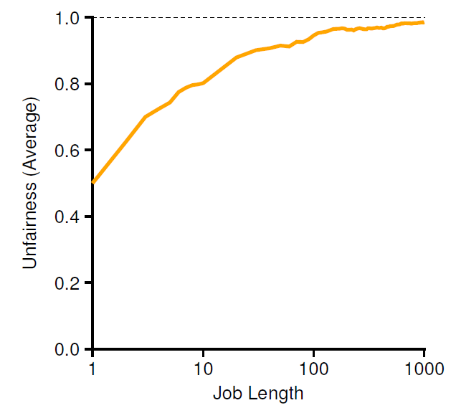
Lottery Fairness Study
There are two jobs.
Each jobs has the same number of tickets (100).
When the job length is not very long,
average unfairness can be quite severe

Slide 45
Stride Scheduling
A deterministic fair share scheduler
Stride of each process
(A large number) / (the number of tickets of the process)
Example: A large number = 10,000
Process A has 100 tickets → stride of A is 100
Process B has 50 tickets → stride of B is 200
A process runs, increment a counter(=pass value) for it by its stride.
Pick the process to run that has the lowest pass value
current = remove_min(queue); // pick client with minimum pass
schedule(current); // use resource for quantum
current->pass += current->stride; // compute next pass using stride
insert(queue, current); // put back into the queue
A pseudo code implementation

Slide 46
Stride Scheduling Example
Pass(A)
(stride=100)
Pass(B)
(stride=200)
Pass(C)
(stride=40)
Who Runs?
0
100
100
100
100
100
200
200
200
0
0
200
200
200
200
200
200
200
0
0
0
40
80
120
120
160
200
A
B
C
C
C
A
C
C
…
If new job enters with pass value 0,
It will monopolize the CPU!

Slide 47
The Linux Completely Fair Scheduler (CFS)
Completely Fair Scheduler (CFS) implements fair-share in an alternate manner.
CFS aims to spend very little time making scheduling decisions.
Recent studies have shown that scheduler efficiency is surprisingly important. It uses about 5% of overall datacenter CPU time.

Slide 48
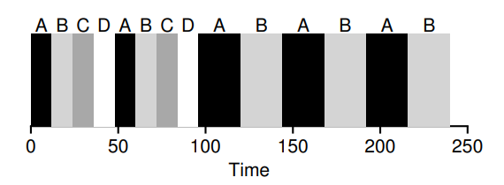
Basic Operation
As each process runs, it accumulates vruntime.
In the most basic case, each process’s vruntime increases at the same rate, in proportion with physical (real) time.
When a scheduling decision occurs, CFS will pick the process with the lowest vruntime to run next.
CFS uses sched latency value to determine how long one process should run before considering a switch (effectively determining its time slice but in a dynamic fashion).

Slide 49

Weighting (Niceness)
CFS also enables controls over process priority, enabling users or administrators to give some processes a higher share of the CPU.
It does this not with tickets, but through a classic UNIX mechanism known as the nice level of a process.
The nice parameter can be set anywhere from -20 to +19 for a process, with a default of 0.
CFS maps the nice value of each process to a weight. Using it, CFS calculates vruntime in an adapted way:

Slide 50
Using Red-Black Trees
If we kept ready (runnable) jobs in an ordered list, finding the next job to run would be simple: just remove the first element.
However, when placing that job back into the list (in order), we would have to scan the list, looking for the right spot to insert it, an O(n) operation.
Could we do better?

Slide 51
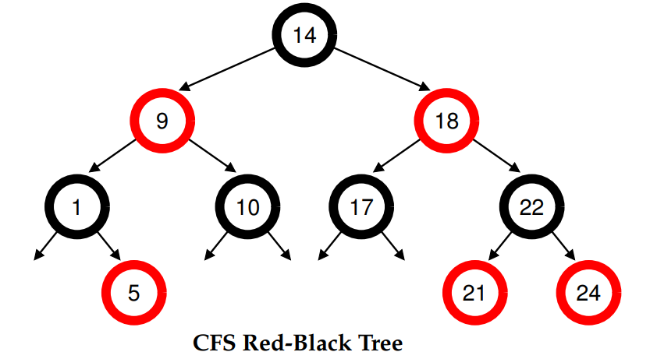
Using Red-Black Trees (Cont’d)
If processes are ordered in the red-black tree by vruntime, then most operations (such as insertion and deletion) are logarithmic in time, i.e., O(log n).
When n is in the thousands, logarithmic is noticeably more efficient than linear.

Slide 52
Dealing With I/O And Sleeping Processes
One problem with picking the lowest vruntime to run next arises with jobs that have gone to sleep for a long period of time.
Imagine two processes, A and B, one of which (A) runs continuously, and the other (B) which has gone to sleep for a long period of time (say, 10 seconds).
When B wakes up, its vruntime will be 10 seconds behind A’s, and thus (if we’re not careful), B will now monopolize the CPU for the next 10 seconds while it catches up, effectively starving A.
CFS handles this case by altering the vruntime of a job when it wakes up. Specifically, CFS sets the vruntime of that job to the minimum value found in the tree (the tree only contains running jobs)

